Slide 1
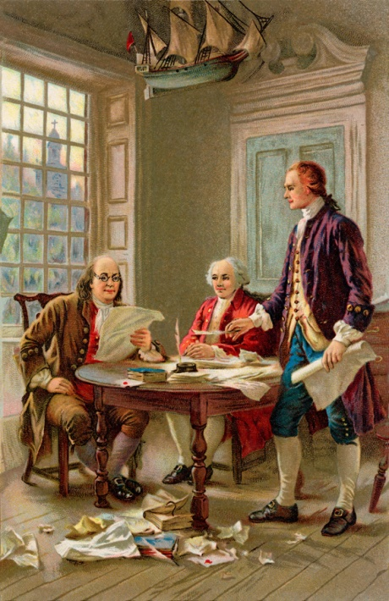
We Declare…
Breaking Down the Declaration

Slide 2
Action and Reaction
After the Boston Massacre and the Boston Tea Party, the colonists decided it was time to take action in reference to the problems they were having with the British crown
Refresher: What were those problems?
  “No taxation without representation”
    What does that mean?
      The colonists felt that tax laws should only be passed in the colonial legislatures, not in England more that 3,000 miles away
  Removal of basic rights – privacy, trial by jury
  Removal of self-government to which they had become accustomed
The Colonists felt it was important to petition for their rights and freedom in response to the British policies by protesting and letter writing.
To petition means to write a formal, written request.
Notes:
The next 4 slides will serve as a review from Parliament v. Patriots.
Review with students the reasons the colonists decided to seek independence (no taxation without representation, removal of rights, infringement on self-government)

Slide 3
The start of something…
Representatives from all colonies met in a general congress once a year to discuss what was happening in the colonies.
This first meeting was called the First Continental Congress
  Colonists met to decide on the best response to the British policies and actions of the British government
.
Notes:
Review the First Continental Congress where colonists discussed how to deal with British policies and the reaction to the British Government.
The colonists decided to ban/boycott trade with Great Britain in hopes the British would repeal (remove) or change the laws/acts.

Slide 4
The shot heard around the world…
On April 17, 1775 British troops marched into the towns of Lexington and Concord to remove guns and supplies from the colonists
The colonists fired on the British troops, forcing them out of the towns and back to Boston
These would be the first shots of the Revolutionary War
Click HERE to watch a short video about the first shots of the Revolutionary War.
Notes:
Short video available at http://www.history.com/videos/first-revolutionary-battle-at-lexington--concord#first-revolutionary-battle-at-lexington--concord

Slide 5
Second Continental Congress
During the next meeting in Congress (Second Continental Congress) shortly after the shots at Lexington and Concord, the delegates decided it was time to resist the British control and establish a new country no longer under control of the British government
Side note:
Sometimes the British government is referred to as the “British crown”. This is because the British government is a monarchy ruled by a king. Thus, the “British crown” would be the same as the “British government”

Slide 6
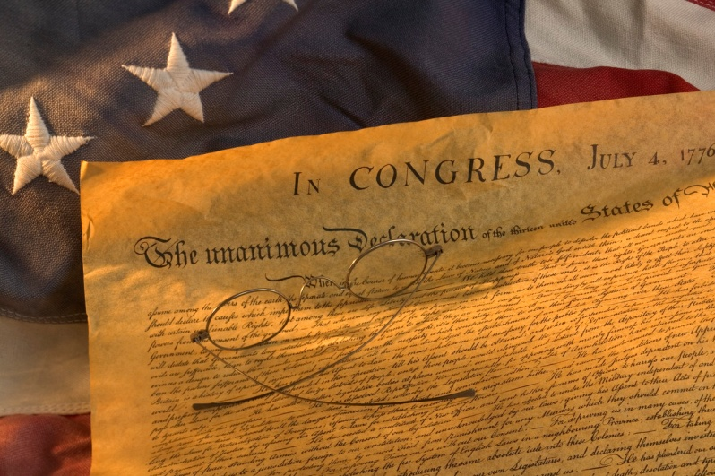

Making it official…
Congress asked a committee to create a document establishing why it was necessary to seek independence from British control.
This document would be the colonists’ Declaration of Independence

Slide 7

Declaration Outline
The Declaration of Independence was divided into 4 sections:
  Ideals
  Arguments
  Complaints/Grievances
  Conclusion
Notes:
Discuss the four sections of the Declaration of Independence. Have students take notes on the various parts. The following slides will describe each section.
A foldable would make an excellent note taking tool for this lesson.
Fold a piece of paper in half the long way (“hot dog”).
Divide the paper into 4 equal sections.
Cut ONE SIDE of the paper into 4 equal sections, creating flaps.
Label each flap with one of the following: Ideals, Arguments, Complaints, Conclusion.
Student can take notes inside of each flap about what each section of the Declaration outlines.

Slide 8
  Ideals – this is where the Founders outlined their beliefs about government, how government should be created, and the ideals and concepts that create a good government
Notes:
Instruct students to take notes on what the ideals in the Declaration will outline.
Discuss ideals with students. Sample questions:
What were some of the Founders’ beliefs about government? (Purpose of government is to protect the rights of the people, there should be a social contract between the government and the people, all people are entitled to natural rights, all should be equal before the law [Rule of Law])
What is important to the Founders in the creation of a government? (Rule of Law, consent of the governed)
What are some of the ideals and concepts that create a good government? (natural rights, protection of the rights of the people, Rule of Law, limited government)

Slide 9
  Arguments – these are the reasons the Founders felt it was necessary to create a new government no longer under British rule
Notes:
Instruct students to take notes on what the arguments in the Declaration will outline.
Ask students why they think the colonists would want to establish their own government no longer under British rule.

Slide 10

  Complaints – the Founders listed grievances against the King (King George). These are things they felt the King had done to violate their rights, and thus justify their separation from the crown
Notes:
Instruct students to take notes on what the complaints in the Declaration will outline.

Slide 11
  Conclusion – the Founders state that there will be a separation from Great Britain and what the rights they will be entitled to as a free nation
Notes:
Instruct students to take notes on what the conclusion in the Declaration will outline.

Slide 12
Seek and Find
Divide class into groups of 4.
Each group is going to be given a copy of the Declaration of Independence (DoI).
Each student in your group will be given a sign with a section of the DoI on it – Ideal, Argument, Complaint, Conclusion.
Quotes from the Declaration of Independence will come up on this presentation.
If you think the quote is from your section, find the quote in the DoI and raise your sign.
You will need to read the sentence before and after your quote in order to get the point for your group, so make sure you find the quote first, and then raise your sign.
Notes:
1. Divide class into groups of 4.
2. Distribute Seek and Find Student Handout
3. Distribute a copy of the Declaration of Independence.
4. Distribute one set of the “Ideals”, “Arguments”, “Complaints”, and “Conclusions” pages to each group.
5. The following slides will have quotes from the Declaration. Students will need to decide which section the quote is from and hold up the correct sign after finding it in the document. Discuss the quotes and allow students time to provide
Follow slide instructions to begin the “Seek and Find” activity.

Slide 13
Round 1
“He has refused to pass other Laws for the Accommodation of large Districts of People, unless those People would relinquish the Right of Representation in the Legislature…”
What does this mean?
Notes:
Section: Complaint against the King.
Translation: The king has refused to pass laws that would promote the expansion of the British colonies to include more people from England, unless those coming to the colonies would give up any representation in the law making body in England.
Answer to question: The King has refused to allow the passing of any law that would allow more people to come to the colonies unless they first give up the right to representation in British government. This would leave them with no rights or voice in the British government.

Slide 14
Round 2
“…these United colonies are, and of Right ought to be, FREE AND INDPENDENT STATES; that they are absolved from all allegiance to the British Crown…”
How would you put that in your own words?
Notes:
Conclusion
Translation (responses will vary): Together the colonies agree that they have the right to be free and independent states and remove themselves from the loyalty of the British crown/government.
Answer to question (answers will vary): Together these colonies have the right to be free and independent states and removed from all loyalty to the British crown/government/King.

Slide 15
Round 3
“For imposing taxes on us without our consent;
For depriving us, in many Cases, of the Benefits of Trial by Jury…”
Why would a trial by jury be an important right to the people?
Notes:
Section: Complaints against the King.
Translation: For taxing us (colonists) without allowing us to have a say. For not allowing us to be tried in court by a jury of our peers.
Answer to question: If the people are not being tried by a jury, there is a strong chance they are being unjustly treated within the justice system.

Slide 16
Round 4
“…to secure these Rights, Governments are instituted among Men, deriving their Powers from the Consent of the Governed, that whenever any Form of Government becomes destructive of these Ends it is the Right of the People to alter or to abolish it, and to institute new Government”
Under what conditions do the people have the right to alter or abolish government?
Notes:
Section: Arguments
Translation: Governments are established to protect the rights of the people. Governments get their power through a social contract with the people. Whenever a government abuses power and no longer listens to the voice of the people, it is the right of the people to change or get rid of that government, and create a new one.
Answer to question: When a government violates the rights of the people and no longer respects the social contract between the people and the government, the people have the rights to alter or abolish (get rid of) the government.

Slide 17
Round 5
“…and to assume among the Powers of the Earth, the separate and equal Station to which the Laws of Nature…entitle them…”
What are the “laws of nature” referred to in this quote?
Remember when we talked about natural law.
Notes:
Section: Ideals
Translation: Natural law is the code by which mankind operates. This quote is a part of the ideals stating that it is the power of the people, by the law of nature, to separate from another entity*
*When students read the quote in context, the translation will be that in the course of human events it may become necessary for one group to separate from another group of people based on natural law. When that is the case, it is the obligation of the group that is separating to give reasons for the separation. Thus, the purpose of the Declaration of Independence.
Answer to question: The laws of nature are those that govern the actions of all people; how we interact in the human race

Slide 18
Round 7
“…that as free and independent states, they have full power to levy War, conclude Peace, contract Alliances, establish commerce, and to do all other Acts and Things which independent states may of right do.”
At this time, why would these be important things to include in the Declaration of Independence to be seen by the crown?
Notes:
Section: Conclusion
Translation: As free states, independent of the British crown, the states have the power to engage in war, declare peace, make alliances (with other countries during a time of war), establish and create businesses, and do anything else free and independent states may have the right to do.
Answer to question: These would be important aspects to outline since the Congress knew they would be engaging in the Revolutionary War with England. They needed to establish that they were prepared to engage in war and operate as a free country.

Slide 19
Round 6
“But when a long Train of Abuses and Usurptions, pursuing invariably the same Object, evinces a Design to reduce them under absolute Despotism, it is their Right, it is their Duty, to throw off such Government, and to provide new Guards for their future Security.”
What is the difference between a right and a duty in this situation?
Notes:
Definitions:
Usurpations: trespass; entry without permission
Despotism: a political system in which the ruler has complete power; usually corrupt or abusive
Section: Arguments
Translation: When a long history of abuse and trespassing creates a system where the people are ruled by someone with complete power, it is the right and duty of those people to get rid of this government and create a new system to promote their security in the future.
Answer to question: It is their right to overthrow the government in that it is something they are able to do based on the laws of nature.
It is their duty to overthrow this government in that they have an obligation (or something they have to do) to check the power of a government that is too powerful and abuses the rights of the people.

Slide 20
Round 8
“We hold these truths to be self-evident, that all men are created equal, that they are endowed by their Creator with certain unalienable Rights, that among these are life, liberty, and the Pursuit of Happiness…”
From which philosopher did the colonists get this concept of natural, or unalienable, rights?
Notes:
Definitions:
Unalienable: cannot be taken from or given away to
Section: Arguments
Translation: We hold these truths to be the obvious truth: all men are created equal and their maker gives them certain rights that can never be taken away. Among those rights are life, liberty, and the ability to be happy.
Answer to question: John Locke

Slide 21
Declaration Drafting Committee
In your group…
  You are going to work as the Declaration Drafting Committee.
  Using what you know about the colonists’ views on government and the reasons they oppose British control, write a brief Declaration of Independence in your own words
  The outline provided will give you a place to write the ideals you wish to express, your arguments for breaking away from British rule, your complaints against the king, and a conclusion to summarize your points.
Notes:
Distribute the Outline for the Declaration of Independence.
Have students work in small groups to create a Declaration of Independence in their own words. Students may use a copy of the Declaration of Independence for guidance.

