Slide 1
Rule of Law
Some REAALLYY fun facts – a BRIEF overview ☺

Slide 2
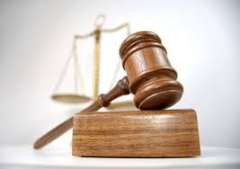
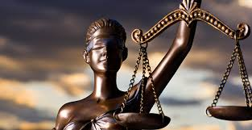
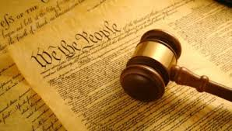
Rule of Law
Title your paper- Rule of Law- and discuss each question with your shoulder partner and record a response on your own paper. Leave room to add comments.
What is the definition of law?
How do laws differ from rules?
Who makes laws?
Who makes rules?
Where do rules and laws apply?
What are some laws that you have encountered today?
Why do we have laws?

Slide 3
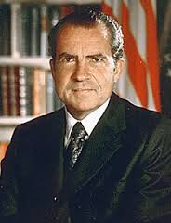
Rule of Law?????
https://www.youtube.com/watch?v=4HZHlygbd4I

Slide 4
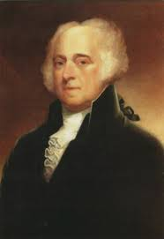
Thoughts?
“I prefer a government of laws and not of man” – John Adams
“When the president does it, it is not illegal.”- Richard Nixon
8. Based on both quotes, how would you summarize John Adam’s and
Richard Nixon’s points of view? Are they similar or different?

Slide 5
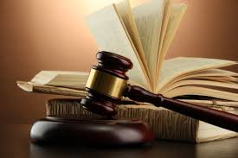
RULE OF LAW????
9. What do you think (or already know) the rule of law means?

Slide 6
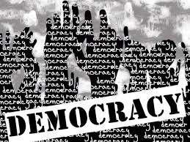
Rule of Law and Democracy
Democracy: Notion that people rule through their government.
Elections
Freedom of speech, peaceable assembly and petitioning the government
In a democracy, the government is responsible for protecting all citizens through the rule of law.

Slide 7
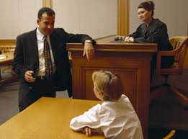
But What is rule of law?
Rule of Law: Notion that ALL citizens are protected from arbitrary and abusive uses of government power.
Applies to non-citizens (though not all aspect apply)
Certain aspects applied differently to certain citizens such as minors and the mentally disabled.

Slide 8
What does Rule of Law look like in the United States
The U.S. Constitution, The Bill of Rights, and other amendments in the U.S. Constitution.
separation of powers and checks and balances
Protect citizens from government abusing its powers
Separation of powers: Dividing the government into three distinct branches.
Checks and balances: Dividing the powers of the government so that no one branch becomes too powerful.

Slide 9
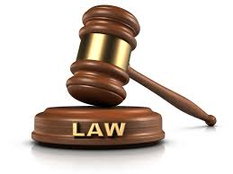
Accountability to the law
Norms, processes, and structures that hold the population and public officials legally responsible for their actions and impose sanctions if they violate the law.

Slide 10
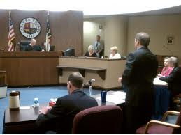
Fair procedures
Decisions will be made on the basis of a set of established rules that are known.

Slide 11
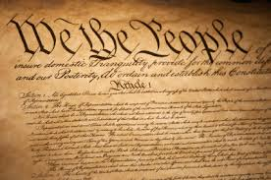
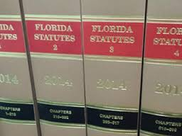
Decisions based on the law
Rights associated the judicial proceedings- right to present evidence/ their view and right to be told what it is they are accused of/see the evidence against them.

Slide 12
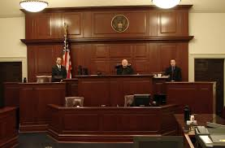
Consistent application
Each person is treated in the same way by the legal system no matter who they are.

Slide 13
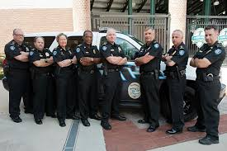
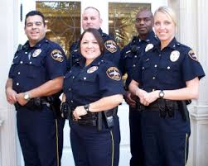
Enforcement of the law
Prevent crime and violence of every sort to protect human security.

Slide 14
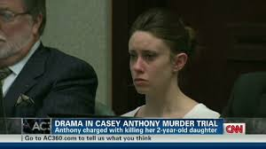
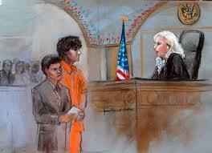
Transparency of institutions
What happens in the legal system can be seen and understood by the general public.
Access to justice: the ability of people to seek and obtain a remedy through formal or informal institutions of justice for grievances.

