Slide 1
Forms of Government
SS.7.C.3.1
Compare different forms of government (direct democracy, representative democracy, socialism, communism, monarchy, oligarchy, autocracy).
Comparing Different Forms of Government

Slide 2
What is the role/purpose of government?
To protect the rights of the people
To keep the people safe
Life, liberty and pursuit of happiness
What else…?

Slide 3
Forms of Government
Direct democracy
Representative democracy
Constitutional monarchy
Absolute monarchy
Oligarchy
Autocracy
Republic
Socialism
Communism
These are the forms of government we will be examining today!

Slide 4
As these governments are being discussed…
Draw a diagram of the government we are discussing.
Think about the definition and illustrate the definition in a way that makes sense to you.
Notes:
Students should individually draw a diagram of the government being discussed. Allow 5 minutes per government for the students to draw.

Slide 5
What is a “democracy”?
Democracy is government by the people, exercised either directly or through elected representatives.
Literally defined as “rule of the people”
Notes:
Discuss definition of democracy (from We the People: the Citizen and the Constitution).

Slide 6
Direct Democracy
Direct Democracy
Based on the definition of “democracy” how would you define a direct democracy?
Draw a picture to illustrate your definition of direct democracy!
Notes:
1. Have students generate their own definition of what they think “direct democracy” means. Discuss responses.
2. Next, have students create an illustrated definition of “direct democracy”. A graphic will be provided in subsequent slides.
3. Discuss the definition of “representative”. Have students create their own definition of what “representative democracy” might mean.
4. Next, have students create an illustrated definition of “representative democracy”. A graphic will be provided in subsequent slides.

Slide 7
What is direct democracy?
Direct democracy is a government where the people have an individual voice in government.
Government
Notes:
Explain the diagram as each individual being allowed to have a say in their government. There is a “direct” connection between the people and the government.

Slide 8
Representative Democracy
Representative Democracy
What is a “representative”?
An elected person to act and speak on behalf of others
Based on the definition of “representative” and “democracy”, how you would define representative democracy?
Draw a picture to illustrate your definition of representative democracy!

Slide 9
What is Representative Democracy?
Representative democracy is a system where individuals have a voice in government through elected representatives
Government
Notes:
Discuss the graphic: each group selects a representative to represent their interests in the government. The people are able to establish a direct link to government through their representative.

Slide 10
What other forms of government are there?
Monarchy
Constitutional monarchy
Absolute monarchy
Oligarchy
Autocracy
Socialism
Communism
Notes:
In the following slides descriptions of the following governments will be provided: communism, monarchy, oligarchy, and autocracy.

Slide 11
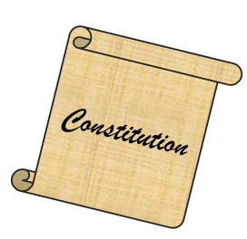
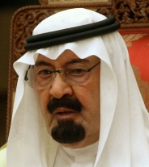
Constitutional Monarchy
A monarchy has a king, queen, emperor or empress.
The ruling position can be passed on to the ruler’s heirs (family).
A constitutional monarchy has a constitution that limits the monarch's power.
Notes:
Discuss the definition with the class. Have students write a brief definition of each type of government on Handout A and an accompanying diagram (should be completed individually).

Slide 12
Constitutional Monarchy
Constitution
Notes:
In a constitutional monarchy, the king or queen serves as a figure head for government with a section of government (ex: Parliament) accessible to the people.

Slide 13
Absolute Monarchy
The monarch (king, queen, etc.) has absolute power among his/her people.
The monarch is the single ruler within the government – rule by one.
The monarch has unrestricted power over the people.
Notes:
Discuss the definition with the class. Have students write a brief definition of each type of government on Handout A and an accompanying diagram (should be completed individually).

Slide 14
Absolute Monarchy
Government
Notes:
In an autocracy there is one ruler, or dictator, with sole control of the government.

Slide 15
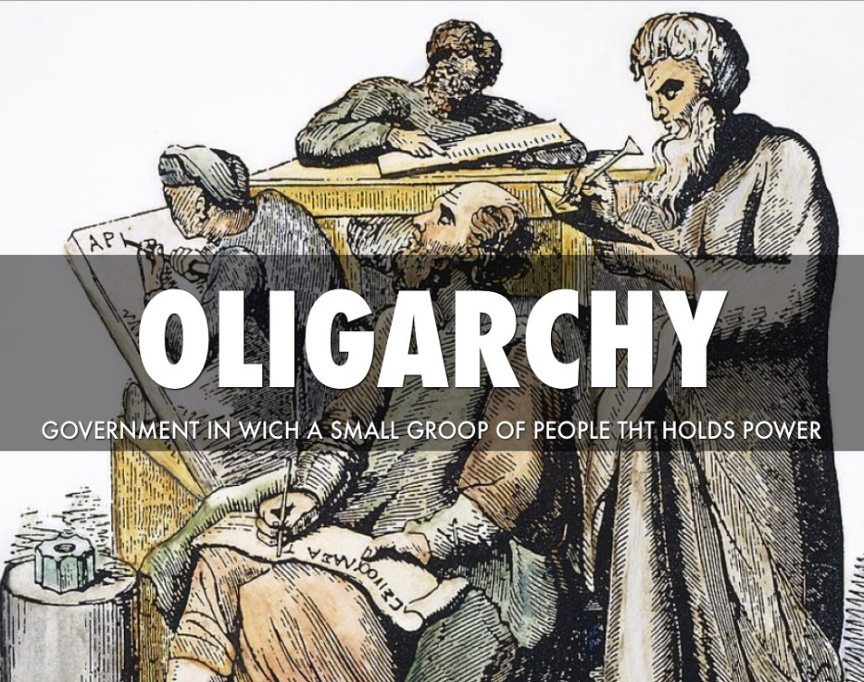
Oligarchy
A government in which control is exercised by a small group of individuals whose authority is generally based on wealth and/or power.
Rule by a “few”
We rule!
Notes:
Discuss the definition with the class. Have students write a brief definition of each type of government on Handout A and an accompanying diagram (should be completed individually).
Image from http://72abfb7c1a8a71411901-4a3d306595cd09781b35fe13ebdb4f63.r27.cf2.rackcdn.com/C1C6BAEF-C82A-4735-B3CC-4D2DF88B3DA8.jpg

Slide 16
Oligarchy
Government
Government
Notes:
In an oligarchy, all of the government’s power is vested in a small group of people within government.

Slide 17
Autocracy
A government ruled by a single leader who has unlimited power and denies peoples’ fundamental rights.
Rule by one
I rule!
Notes:
Discuss the definition with the class. Have students write a brief definition of each type of government on Handout A and an accompanying diagram (should be completed individually).

Slide 18
Autocracy
Government
Notes:
In an autocracy there is one ruler, or dictator, with sole control of the government.

Slide 19
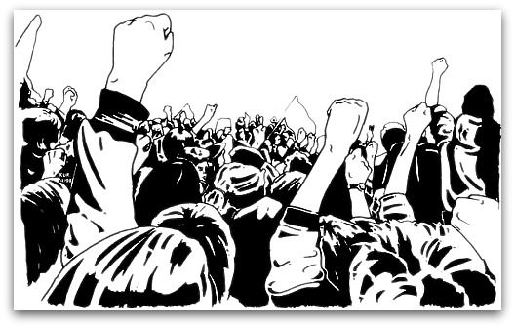
Anarchy
A society where there is no government
Reminder: what is the purpose of government?
To protect the rights of the people
To keep the people safe
Life, liberty and pursuit of happiness
Notes:
Discuss the definition with the class. Have students write a brief definition of each type of government on Handout A and an accompanying diagram (should be completed individually).

Slide 20
Anarchy

Slide 21
What else is there?
Republic, Socialism, and Communism

Slide 22
Republic
A republic is a form of government limited by written law (in our case, the U.S. Constitution) in which power is held by the people.
Like a representative democracy, citizens elect others to represent their interests in government.

Slide 23
Socialism
Economic system that limits individual ownership
Still provides the opportunity for private property and private wealth
Notes:
There are MANY different definitions of the terms “socialism” and “communism” available. The one provided is a streamlined compilation of multiple definitions.

Slide 24
Communism
In a communist government, the government owns all means of production and eliminates private property/business.
This means that all things are owned by the government and shared by the community.
Notes:
There are MANY different definitions of the terms “socialism” and “communism” available. The one provided is a streamlined compilation of multiple definitions.

Slide 25
A Teenage Girl Explains Different Forms of Government
Video created and published by “A Teenage Girl Explains” on YouTube.
Notes:
https://www.youtube.com/watch?v=WEEuwmMIPas
This just provides a student representation of different forms of government. A complete explanation is not provided for each form of government, but it does provide for a simplified explanation and visual at a middle school level.

Slide 26
What do you think?
If you were to have your own country, which form(s) of government would you put in place?
Explain your answer!

Slide 27
Checking for Understanding

