Slide 1
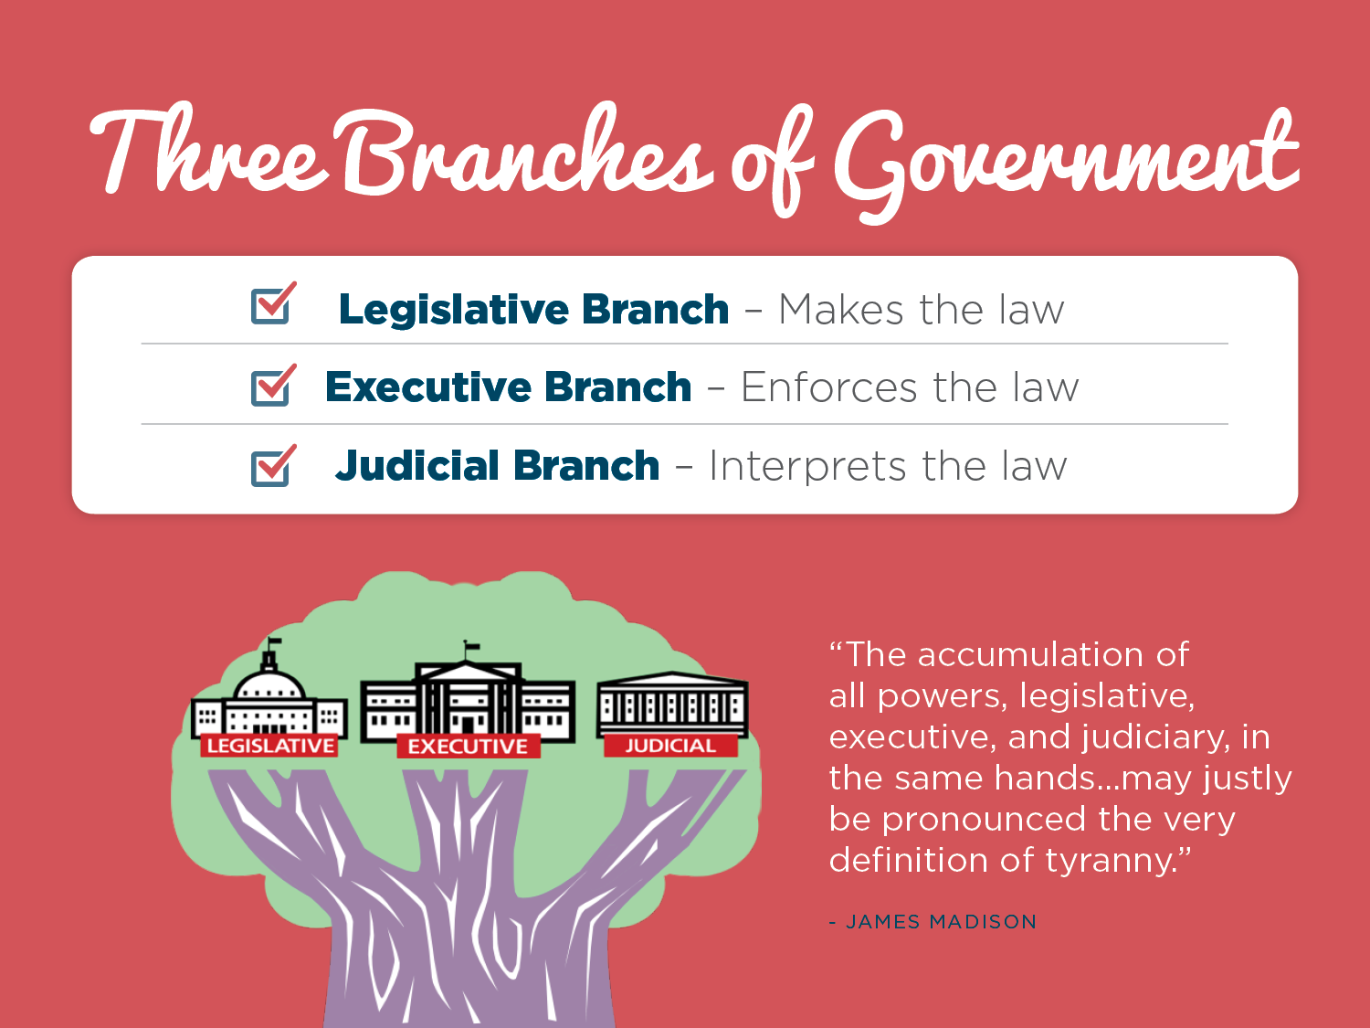
Branching Out
SS.7.C.3.3 Illustrate the structure and function (three branches of government established in Articles I, II, and III with corresponding powers) of government in the United States as established in the Constitution.
The Structure and Function of the Federal Government

Slide 2
What is a Constitution?
Establishes a plan of government or rule book for government
Serves as a contract between the people and the government
Sets forth the structure and
functions of government
Lists some of the rights of the
people…
What else would you add?
Notes:
Review what a constitution is and what our Constitution does.

Slide 3
The separation of Power
How does the U.S. Constitution set up the structure of our government?

Slide 4
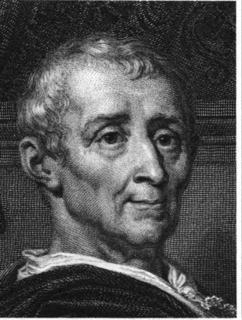

Separation of Power
Montesquieu argued that in order to keep a government from becoming too powerful:
  Power must be separated
  Power must be checked
  Power must be balanced
POWER
POWER
POWER
POWER
POWER
POWER
POWER

Slide 5

Power
M
Executive
Judicial
Legislative
Notes:
The purpose behind this image is to remind students that Montesquieu (M) was the philosopher who proposed that separation of power (in this case into three branches of government) was essential to making sure government was not corrupt and that no one person or group was able to become too powerful.

Slide 6
Interprets and applies the law
Notes:
Briefly highlight the three branches and the corresponding responsibilities of each. The Framers designed a government with separation of powers and checks and balances.
Briefly highlight The Founders split the government into different parts to prevent the abuse of power by any one branch.
Emphasize the dangers of placing all responsibilities into one branch of government. What if the President or Governor was responsible for making the law and enforcing the law as well as interpreting the law.
The James Madison quote is from The Federalist #47.
*

Slide 7
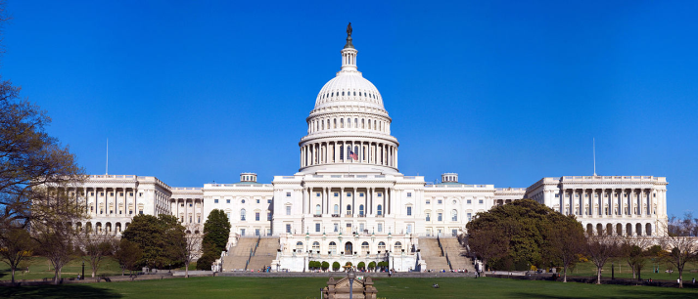
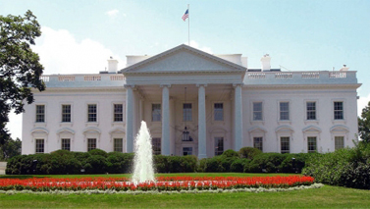
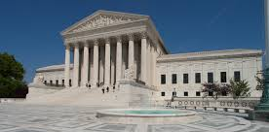
Branches of Government
ARTICLE 1
ARTICLE 2
ARTICLE 3
LEGISLATIVE BRANCH
EXECUTIVE BRANCH
JUDICIAL BRANCH
Where do we find the branches of government outlined in the U.S. Constitution?
Notes:
Where is this found? Using the United States Constitution identify the branches of government. Highlight where you find this information within the Constitution.

Slide 8
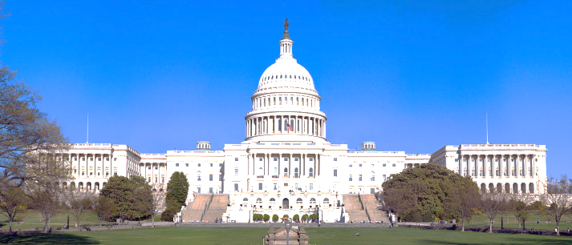
Structure of the Branches
ARTICLE 1 Legislative Branch
ARTICLE 2
Executive Branch
ARTICLE 3
Judicial Branch
Also known as:
CONGRESS
Senate
100 members
(2 per state)
House of Representatives
435 members
(based on population)
Supreme Court
9 Justices
Other inferior courts
President
Vice President
Cabinet
Notes:
The information should be provided in layers. To start, each branch of government is outlined in its respective Article of the United States Constitution. The presentation then goes on to include a synonym for the legislative branch (Congress) and who composes that branch (the House of Representatives and the Senate). The PowerPoint will do the same for the Executive and Judicial branches. Make sure to emphasize for students that the legislative branch and Congress are one in the same. Students should create a visual of the final slide in their notes to illustrate the structure of the branches of government.

Slide 9

Who has the Power?
How does the Constitution distribute power among the three branches of government?

Slide 10
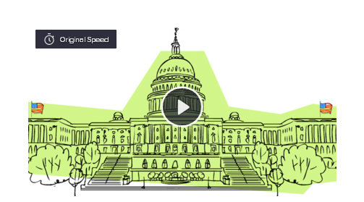
Flocabulary
Click the image to be directed to Flocabulary’s Three Branches of Government Rap
This video and accompanying lyrics were created and published by Flocabulary.
Notes:
Distribute Handout A – Flocabulary Lyrics. Students should follow along. Discuss some of the terms that are in bold on the handout and use the following slide to identify those as powers of the different branches of government.
https://www.flocabulary.com/3-branches-of-government/

Slide 11

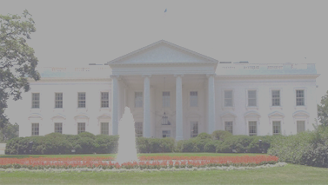
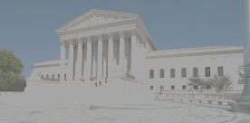
Powers of the Branches
ARTICLE 1 Legislative Branch
Congress
ARTICLE 3
Judicial Branch
ARTICLE 2
Executive Branch
Interpret and apply the law
Make Law
Execute the law
Approve the President’s budget
Declare war
Senate approval/rejection of treaties
Senate approval and rejection of Presidential appointments
Approve or veto Congress’ bills
Direct the military
Write the federal budget
Make foreign policy/treaties
Make appointments
Decide if laws are unconstitutional
Decide court cases
Settle cases between 2 or more states
Notes:
Highlight the roles and responsibilities of each branch of government. Students should compare these roles to see how the separation of power prevents corruption in our government system.

Slide 12
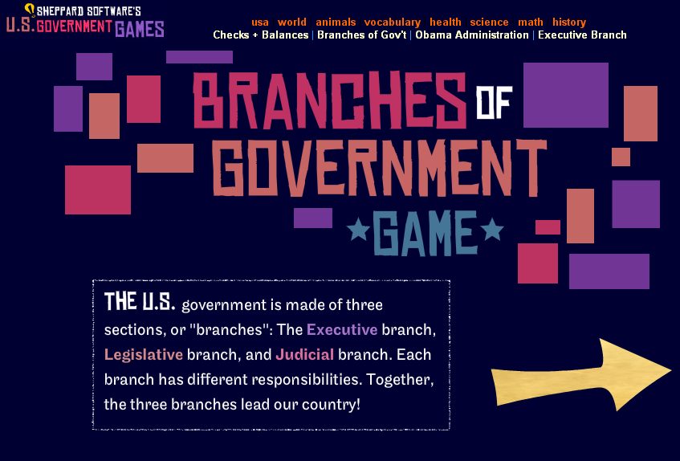
Branches of Government Game!
Click on the image to play the Branches of Government game from Sheppard Software!
Notes:
Assign this game to all students either individually or in pairs.
http://www.sheppardsoftware.com/usa_game/government/branches_government.htm

Slide 13
Types of Powers
Delegated
Implied
Concurrent

Slide 14
Delegated Powers
Also known as:
Enumerated Powers
Expressed Powers
Powers that are expressly listed/outlined in the United States Constitution
Notes:
Delegated powers and enumerated powers are the powers expressly and specifically granted or assigned in the Constitution. Look in Article One and highlight the powers expressly given to the legislative branch. See Article One, Section 8.

Slide 15
Delegated Power Scavenger hunt!
The next slide will list some of the powers of a branch of government.
Your group will be assigned one power.
Find the power in the U.S. Constitution.
When you find the power, have one group member stand up.
Read the quote aloud from the Constitution when called upon.
Notes:
Divide the class into 8 groups. Provide each group with one power listed on Teacher Handout A. The students will then:
1. Find the power in the U.S. Constitution.
2. Have one group member stand up when they find the power.
3. Read the quote directly from the Constitution aloud when called upon. Have the student identify which branch of government that power belongs to.

Slide 16
Approval of presidential appointments
Naturalization and immigration laws
Sole power to try all impeachments
Armed forces
(Army and Navy)
Coin and print money
Declare war
Foreign relations
Regulation of trade
Notes:
These powers are easily found because they are expressly written and laid out within the U.S. Constitution.

Slide 17
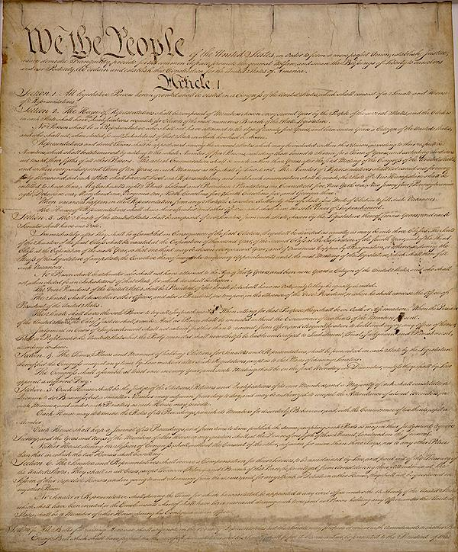
Article I, Section 8
Article I, Section 8 clearly outlines the powers of Congress
These are a great example of delegated/enumerated/expressed powers!

Slide 18
Implied Powers
Powers that are not expressly outlined in the Constitution, but are reasonably suggested by delegated powers.
Also known as:
Elastic Clause
Necessary and Proper Clause
Notes:
Emphasize to students that this power, unlike the ones they just looked at, is not expressly written out in the Constitution.
Definition provided by We the People: the Citizen and the Constitution text.

Slide 19

Implied Powers, Continued
Also known as: Elastic Clause
Article I, Section 8, Clause 18: “To make all Laws which shall be necessary and proper…”
Also known as: Necessary and Proper Clause
Congress can STRETCH their power to make laws that are needed to perform their other duties/responsibilities.
Notes:
Definition provided by We the People: the Citizen and the Constitution text.

Slide 20
Concurrent Powers
Powers that are shared by the Federal and State governments
Powers Delegated to Federal Government
Powers Reserved for State Government
Concurrent Powers
Can you think of something that would go in the middle?
TAXES
Notes:
Powers that held by both the federal and state governments such as the ability to levy taxes. State government and federal government can tax people.

Slide 21
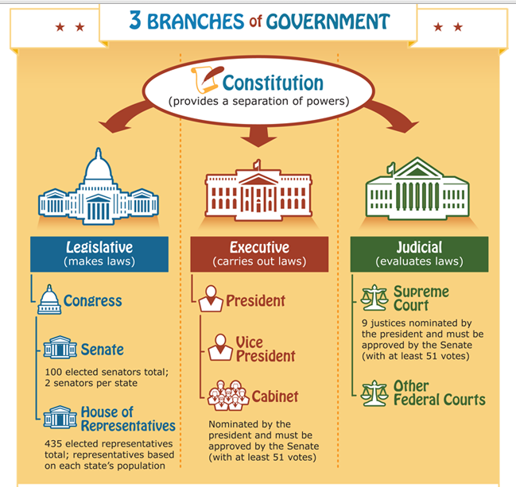
How would you draw it?
Using your Branching Out handout, illustrate the three branches of government in one image.
You can use chart paper, an online platform (like an infographic or glogster), or some other creative form to illustrate the structure and function of the branches of government!
Image from https://kids.usa.gov/sites/all/themes/kids/images/Three_Branches_Govt.png
Notes:
Develop your own visual to help you remember the three branches, what each branch is responsible for and what each branch does. Highlight some of the powers. Can do on chart paper and post around room or prepare an infographic or glogster poster etc.

Slide 22
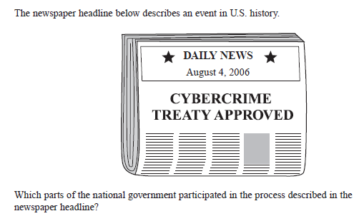

Answer the question below:

