Slide 1
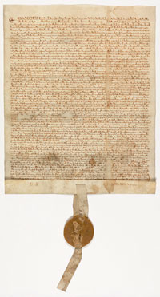
Inspiration for a New Nation
SS.7.C.1.2 Trace the impact that the Magna Carta, English Bill of Rights, Mayflower Compact, and Thomas Paine’s Common Sense had on colonists’ views of government.
Historical Documents and Their Impact on the Founders

Slide 2
First of all….Foldable Notes!
Follow these steps to make foldable notes for this lesson:
Fold one sheet of paper in half, long ways (hot dog), to create a crease. Unfold paper and lie flat.
Cut one side in 4 equal parts, creating flaps.
When folded in half, it will look like the image below.
Notes:
Students show follow instructions on slide using a sheet of regular notebook/computer paper.
Fold in half long ways.
Divide the sheet into 4 equal parts. Cut one side in 4 equal parts creating flaps.

Slide 3
Label Your Foldable:
Magna Carta
Mayflower Compact
English Bill of Rights
Common Sense
Notes:
Students should label the front of flaps according to the diagram provided on the slide.
Inside, students should write on the appropriate flap 1. information about the document 2. the main ideas expressed in the document.

Slide 4


Inspiration for a New Nation
Where did the colonists and the Founding Fathers get their ideas about our government?
Notes:
Ask students where they think the colonists and Founders got their ideas about our government. Discuss responses.

Slide 5
Magna Carta
Written in 1215 in England
Also known as the “Great Charter”
Written by the barons (title of nobility given to those loyal to the king)
Granted certain rights and liberties to English nobles:
  Right to a jury and speedy trial
  Guarantees against the loss of life, liberty, or property
Was agreed to by King John of England – no one was above the law
"To no one will We sell, to no one will We deny or delay, right or justice.“
National Archives and Records Administration. "Featured Document: The Magna Carta." National Archives and Records Administration. Web. 28 Mar. 2012. <http://www.archives.gov/exhibits/featured_documents/magna_carta/>.
Notes:
Discuss facts about Magna Carta and instruct students to write information about the document in the appropriate section of their foldable note taker.

Slide 6
Magna Carta
This was the first example
of limited government.
Specifically, a limited monarchy
Why is the concept of “limited government” important?
What would a government without limits be like?
Notes:
The main ideas in the Magna Carta are limited government and the Rule of Law.
Discuss why limited government is so important. Try to have students make a connection to Montesquieu and the separation of power and the need to check power.
Rule of Law will be further discussed on the following slide.

Slide 7
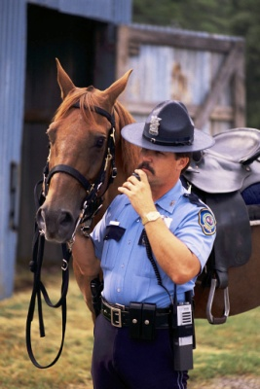


The Magna Carta also addressed the “Rule of Law”
What do you think “Rule of Law” means?
  No one – not the King, the President, celebrities, you, the teacher, the principal – is above the law.
  Everyone is equal under the law
RULE OF LAW
Notes:
Ask students what they think “rule of law” means. Discuss responses.
The Rule of Law is that no one is above the law and the law applies to everyone. Ask students if they think this is important to outline in a government. If so, why? If not, why not?

Slide 9
Magna Carta
Inspiration for the Nation
Limited Government
Rule of Law
Notes:
This slide will appear multiple times to outline all of the main ideas from the documents the Founders used in moving towards declaring independence and utilizing in the creation of the new government.

Slide 10
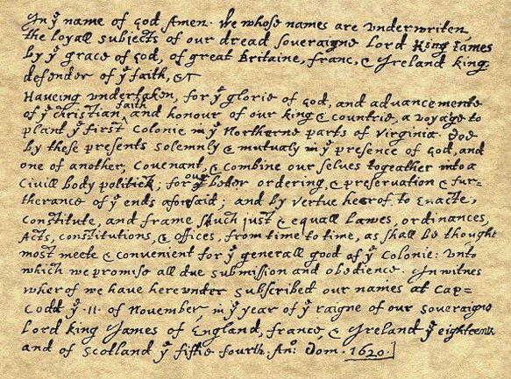
Mayflower Compact
Written aboard the Mayflower in 1620 before the ship landed in Plymouth, Massachusetts in 1620.
Signed by most passengers on the voyage
Image from http://www.historyplace.com/unitedstates/revolution/revgfx/may-compact.jpg
“…Having undertaken…a Voyage to plant the First Colony in the Northern parts of Virginia, do by these present solemnly and mutually in the presence of…one another, Covenant and Combine ourselves together into a Civil Body Politic, for our better ordering and preservation…to enact constitute, and frame such just and equal Laws, Ordinances, Acts, Constitutions, and offices from time to time , as shall be thought most meet and convenient for the general good of the colony…”
Notes:
Students should write facts about the Mayflower compact in the appropriate section of the foldable note taker.
Either read the quote aloud to the students or have multiple students read different sections. Discuss the quote with the students, focusing on the highlighted portions.
The highlighted portions discuss the ideas of self government, social contract, and the need for government to maintain order.

Slide 11

Mayflower Compact
This document served as an example of self -government and John Locke’s social contract.
Why would the colonists want to create a document establishing self government?
GOVERNMENT
SELF
Why would government be necessary according to the Mayflower Compact?
“…For our better ordering and preservation…”
Notes:
Discuss the main ideas of self government and consent of the governed (make connection to John Locke). Review what it would be like to live in a state without any government and discuss the need for government to maintain order and to protect the rights of those living under the government.

Slide 12
Magna Carta
Inspiration for the Nation
Mayflower Compact
Limited Government
Rule of Law
Self-government
Social contract

Slide 13
English Bill of Rights
Written in 1689 in England
Authored by members of Parliament (the legislative branch, or the branch that makes laws)
This document established a limited monarchy (king) and gave more power to Parliament.
  That excessive bail ought not to be required, nor excessive fines imposed; nor cruel and unusual punishments inflicted.
  “That the freedom of speech, and debates or proceedings in parliament, ought not to be impeached or questioned in any court or place out of parliament.”
Notes:
Discuss the facts about the English Bill of Rights.
Have student read the quotes aloud. Discuss the meaning on each quote.
Blue quote: no excessive bail or fines, no cruel and unusual punishment (later found in the Constitution)
Green Quote: Freedom of speech and debate in parliament is not to be limited or questioned out of parliament

Slide 14
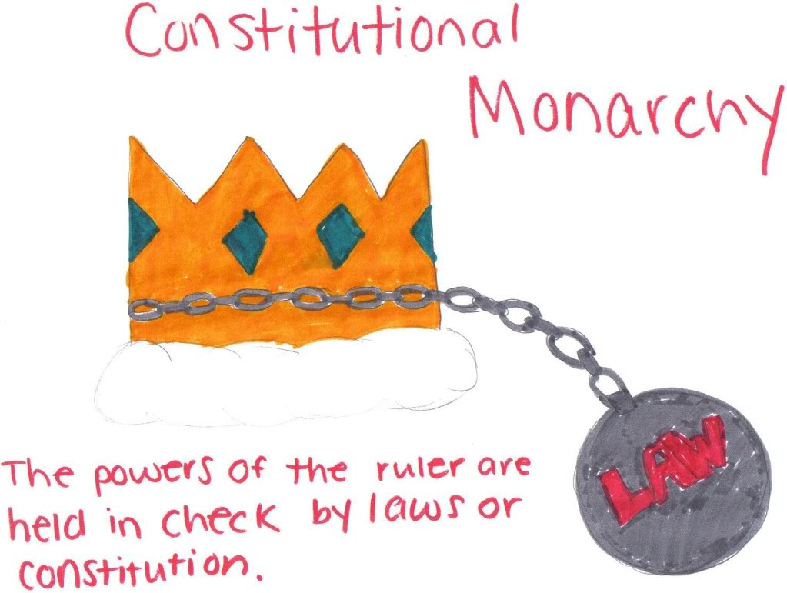
English Bill of Rights
  The monarchy was not allowed to:
    Collect taxes without consent of Parliament
    Interfere with the right to free speech and debate in Parliament
    Maintain an army in peace time
    Require excessive bail or cruel punishments for those accused or convicted of crimes
    Declare laws made by Parliament should not be obeyed
Here we have another example of limited government.
Image from https://encrypted-tbn3.gstatic.com/images?q=tbn:ANd9GcTVO5jN2AnEL_TaogggW9F7PxjDWiIBgaD4kSyG4KPA1uWDTvfH
Specifically, a limited monarchy
Notes:
The English Bill of Rights created a limited monarchy and thus, a limited government. It also reinforced the idea of Rule of Law.
Image from: https://encrypted-tbn3.gstatic.com/images?q=tbn:ANd9GcTVO5jN2AnEL_TaogggW9F7PxjDWiIBgaD4kSyG4KPA1uWDTvfH

Slide 15
Also in the English Bill of Rights …
RULE OF LAW
The English Bill of Rights included limits on the power of the king.

Slide 16
Magna Carta
Inspiration for the Nation
Mayflower Compact
Limited Government
Rule of Law
Self-government
Social contract
Limited Monarchy
Rule of Law
English Bill of Rights

Slide 17
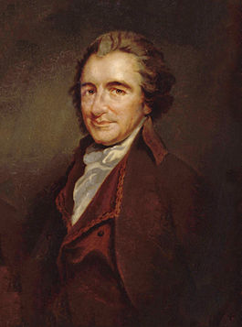
“Common Sense”
Written by Thomas Paine
Published in 1776
Challenged the authority of the British government and the royal monarchy.
First work to openly ask for independence from Great Britain.
Discussed the purpose of government and the need for independence from Great Britain.
Because these things were COMMON SENSE!
Oil painting by Auguste Millière (1880) from http://en.wikipedia.org/wiki/Thomas_Paine
Notes:
Students should write information about Common Sense in the appropriate section on their foldable note taker.

Slide 18
Common Sense
Society in every state is a blessing, but Government, even in its best state, is but a necessary evil…Wherefore, security being the true design and end of government, it unanswerably follows that whatever form thereof appears most likely to ensure it to us, with the least expense and greatest benefit, is preferable to all others.
Notes:
Have students read the quote aloud. Discuss the key points highlighted.
The main function of government is to provide security for the people with the least expense to the people (not sacrificing their rights) and the greatest benefit to all.

Slide 19
Magna
Carta
Inspiration for the Nation
Mayflower Compact
Limited Government
Rule of Law
Self-government
Social contract
Limited Monarchy
Rule of Law
Purpose of Government – security of the people
English Bill of Rights
Common Sense

Slide 20
Quotable Documents
Each group will receive a quote from one of the documents discussed earlier.
In your group:
Identify the document.
Identify the main idea in the given quote.
Create an illustration of the main idea on chart paper.
Notes:
Students will need to:
Identify the document and write it on the top of their chart paper. Students may need access to online resources to confirm the correct document.
Identify the main idea in the given quote and write the concept under the document name.
Create an illustration of the main idea on chart paper.

Slide 21
Document Timeline
English Bill of Rights
1689
Established a limited monarchy and gave power to the law making body . It also reinforced the idea of Rule of Law.
Magna Carta
1215
Created the first example of a limited monarchy and the rule of law.
Mayflower Compact
1620
Provided for the idea of self government and social contract among the colonists.
Common Sense
1776
Discussed the purpose of government and the need for American independence from the British crown.
Notes:
This slide gives a brief overview and timeline of the documents that contributed to the Founders’ ideas about good government. Students should note the dates on their foldable. The Foldable is now a timeline study guide to remember the concepts from these key documents.

Slide 22
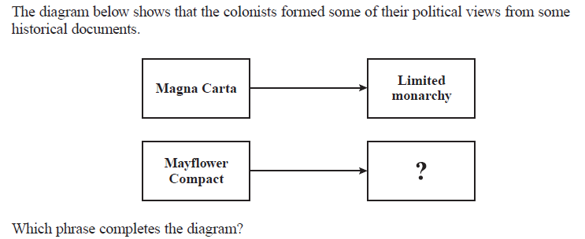
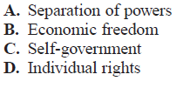
Checking for Understanding

