Slide 1
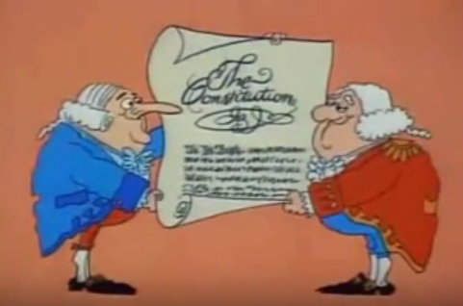
Preamble Breakdown
SS.7.C.1.6
Interpret the intentions of the Preamble of the Constitution.
Interpreting the intentions of the Preamble of the U.S. Constitution
Notes:
Image from Schoolhouse Rock: The Preamble of the Constitution

Slide 2

What is a Preamble?
Preamble- An introduction
*The Preamble to the U.S. Constitution provides an introduction to the Constitution.

Slide 3

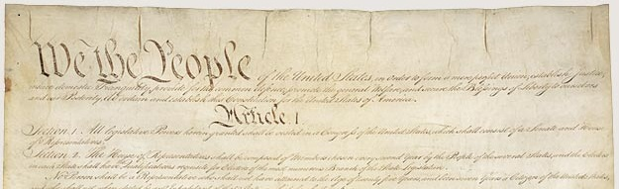
We the People of the United States,
Who are We the People ?
Every person in the United States
This means that the government depends on the people for its power and exists to serve them.

Slide 4
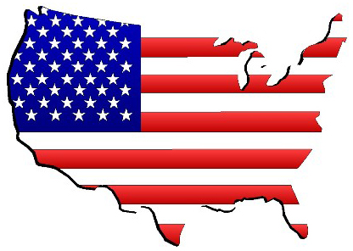
…in order to form a more perfect Union,
What is a “Union” in context of the Preamble?
The “Union” refers to the United States.
How would you put “in order to form a more perfect Union” in your own words?

Slide 5
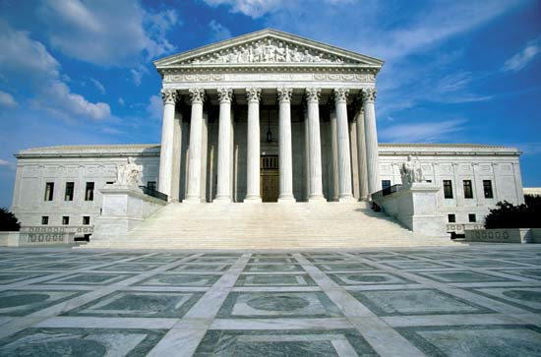
…establish Justice,
What does “justice” mean?
Fairness; the act of applying or upholding the law
How would you put “establish justice” in your own words?

Slide 6
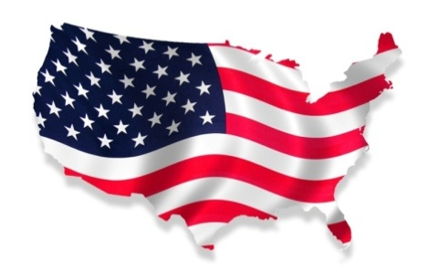
…insure domestic tranquility,
What does “domestic” mean?
Within a country
What does “tranquility” mean?
Peace
domestic + tranquility = ?
Peace within a country
How would you put “insure domestic tranquility” in your own words?

Slide 7
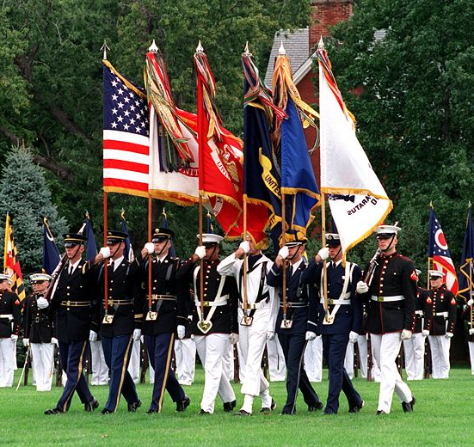

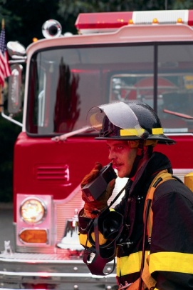
…provide for the common defense,
What does “common defense” mean?
Security of all people
How would you put “provide for the common defense” in your own words?
Notes:
Defense is spelled defence in the Constitution
Image from http://en.wikipedia.org/wiki/United_States_Armed_Forces

Slide 8

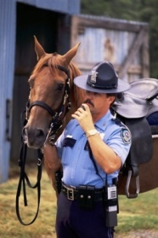


…promote the general Welfare,
What does “Welfare” mean in the context of the Preamble?
Well- being; the state or condition of being healthy, safe, happy, and/or prospering
How would you put “promote the general welfare” in your own words?

Slide 9
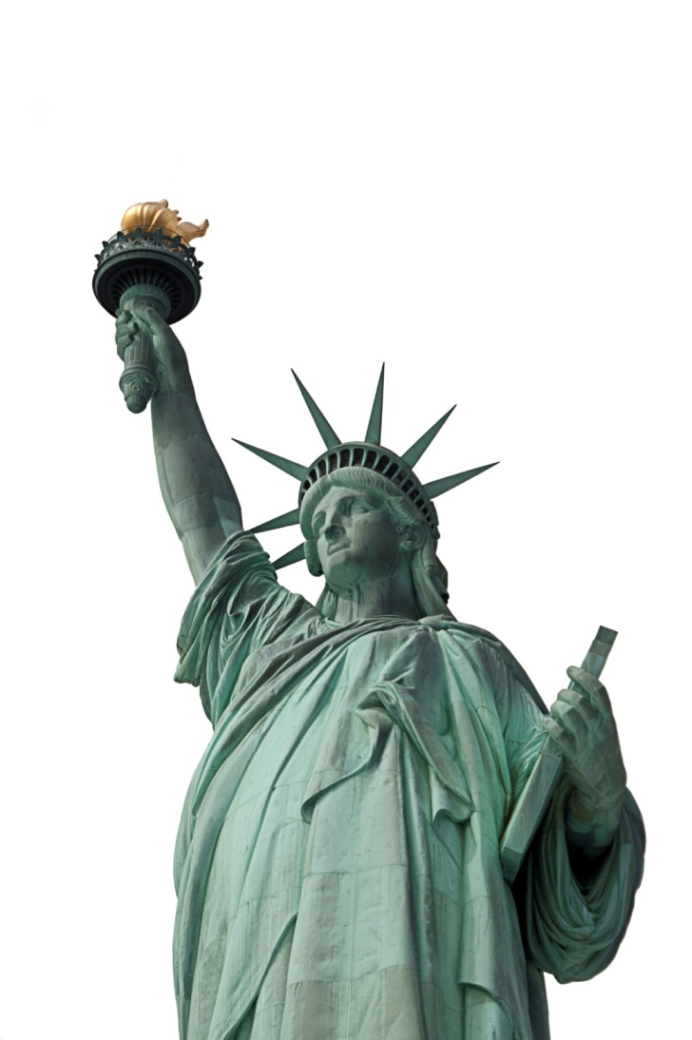
…secure the Blessings of Liberty to ourselves and our Posterity,
What does “liberty” mean?
freedom
What does “posterity” mean?
All future generations
How would you put “Secure the blessings of Liberty to ourselves and our Posterity” in your own words?

Slide 10
…do ordain and establish this Constitution for the
United States of America.
What does “ordain” mean?
Establish formally or by law
How would you put “Do ordain and establish this Constitution for the United States of America” in your own words?

Slide 11
Think About It
How does the government today:
Establish justice?
Insure domestic tranquility?
Provide for the common defense?
Promote the general welfare?
Secure the blessings of liberty for ourselves and our posterity?
Talk in your small group and provide 2 modern examples of how the government still carries out the intentions of the Preamble.

Slide 12
Schoolhouse Rock: The Preamble
Notes:
https://www.youtube.com/watch?v=yHp7sMqPL0g

Slide 13

Checking for Understanding

