Slide 1
Enlighten Me
SS.7.C.1.1
Recognize how Enlightenment ideas including Montesquieu’s view of separation of powers and John Locke’s theories related to natural law and how Locke’s social contract influenced the Founding Fathers.
Influential Enlightenment Ideas
Un “Locke-ing” natural law and social contract and understanding Montesquieu’s separation of powers

Slide 2
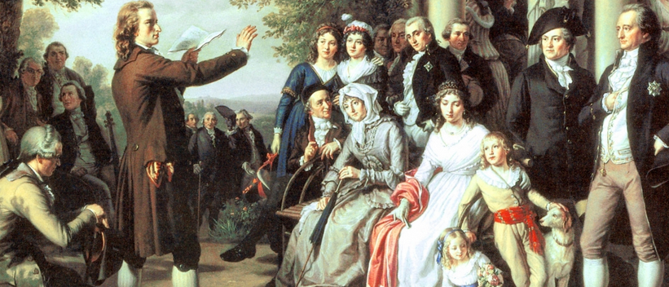
What was “The Enlightenment”?
Also known as the “Age of Reason”
Period in history from 1685-1815 characterized by dramatic revolutions in science, philosophy, society and politics
http://cdn.history.com/sites/2/2014/01/englightenment-hero-H.jpeg
Notes:
Identify and describe Enlightenment ideas…
A name students might be familiar with from this period is Sir Isaac Newton and his theories on gravity. This will just give students a point of reference for the time.
http://cdn.history.com/sites/2/2014/01/englightenment-hero-H.jpeg

Slide 3
How would you define it?
Natural Law
Social Contract
Separation of power
Write your definition on a sheet of paper.
Notes:
Students should define these words to the best of their ability using context clues. Walk students through possible definitions by presenting one word at a time for definition.

Slide 4
Natural Law
A set of rules that people naturally follow without being told to by a government.
Notes:
Natural laws are based on reason. The concept of natural law was developed by English philosopher John Locke.

Slide 5
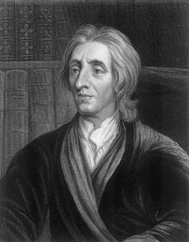
Natural Rights
The concept that all human beings have basic rights, like life, liberty, and property.
People create governments to protect those rights.
“Locke” down your rights
John Locke
English Philosopher
Notes:
Locke also explored the idea of natural rights

Slide 6
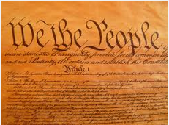
Social Contract
-An agreement among the people to set up a government and obey its laws.
-Gov. protects people’s natural rights.
-Consent of governed: people give the gov. power.
Notes:
In addition to social contract, the concept of “consent of the governed” is important as well. This is the expressed agreement by the people to obey the laws and the government they create.

Slide 7
Social Contract
Government
The people
Social
Contract
John Locke
English
Philosopher
Notes:
The “Locke” is to help students remember the concept of social contract as a connection between the government that is created by the people.

Slide 8
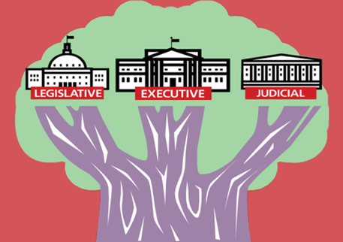
Separation of Power
The division of powers among the different branches of government.

Slide 9
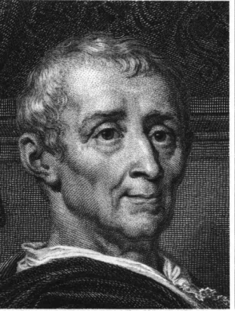
Separation of Power
Montesquieu argued that in order to keep a government from becoming too powerful:
Power must be separated
Power must be checked
Power must be balanced
POWER
POWER
POWER
POWER
POWER
POWER
POWER

Slide 10
Power
M
Legislative
Executive
Judicial
Notes:
The purpose behind this image is to remind students that Montesquieu (M) was the philosopher who proposed that separation of power (in this case into three branches of government) was essential to making sure government was not corrupt and that no one person or group was able to become too powerful.

Slide 11
Concepts and Quotes Making the connection
In a small team, read each of the following quotes and decide which concept is being addressed:
Natural law
Social Contract
Separation of powers
*For an extra point, name the philosopher (Locke or Montesquieu) too!

Slide 12
We the People of the United States…do ordain and establish this Constitution for the United States of America.
Locke’s Social Contract
The Government
The people
Social
Contract
Notes:
This is from the Preamble of the United States Constitution. Locke’s Enlightenment idea of social contract is demonstrated in the first 3 words…We the People.
The image of the lock binding the people to the government is intended to help students remember this is Locke’s philosophy

Slide 13
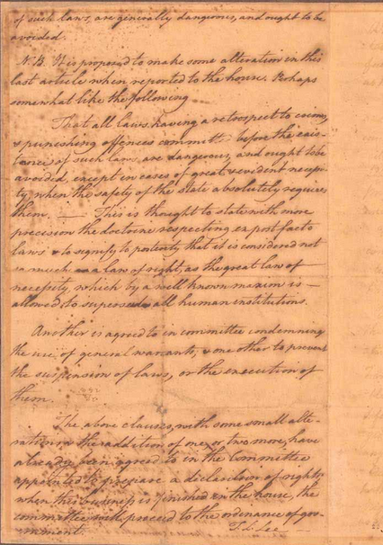
That the legislative, executive, and judicial department shall be separate and distinct…
Montesquieu’s separation of powers
M
Executive
Judicial
Legislative
Notes:
This is from the Virginia Declaration of Rights. The Founding Father’s belief in Montesquieu’s Enlightenment idea of separation of power is demonstrated through the creation of separate branches of government.
The “M” image is to represent that the separation of powers is Montesquieu’s Enlightenment idea.

Slide 14
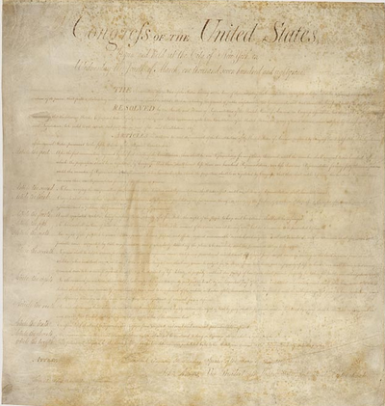
We hold these truths to be self-evident, that all men are created equal, that they are endowed…with certain unalienable rights…
ocke
Natural Law
Notes:
This is from the Declaration of Independence. We can see Locke’s Enlightenment philosophy of natural law reflected in the statement that “all men are created…with certain unalienable rights…”

Slide 15
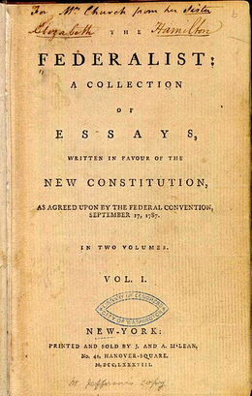
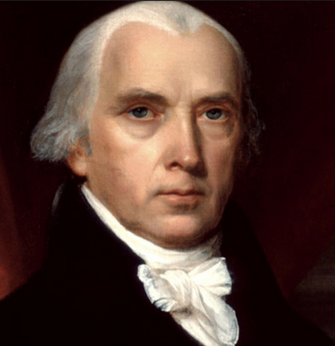
The accumulation of all powers, legislative, executive, and judiciary, in the same hands…may justly be pronounced as the very definition of tyranny.
M
Montesquieu’s separation of powers
Executive
Judicial
Legislative
Notes:
This is from the Federalist Papers, which were articles and essays written by some of the Founders in support of the Constitution. Montesquieu’s separation of powers is reflected in the established need for the separation of powers.

Slide 16
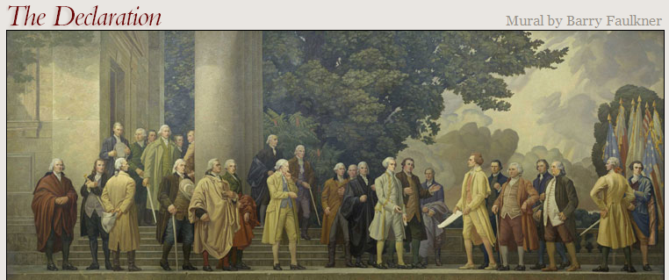
That to secure these Rights, Governments are instituted among men, deriving their powers from the Consent of the Governed…
Locke’s Social Contract
The Government
The people
Social
Contract
Notes:
This is from the Declaration of Independence. We can see Locke’s Enlightenment philosophy of social contract reflected in the consent of the governed and the creation of governments among the people.

Slide 17
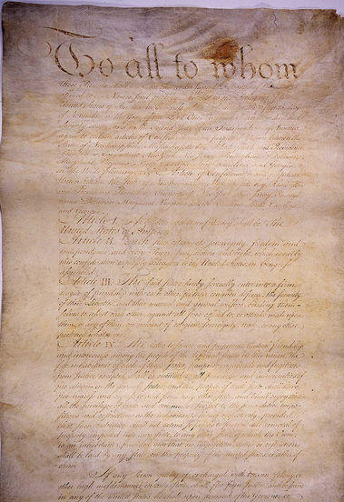
The said States hereby severally enter into a firm league of friendship with each other, for their common defense, the security of their liberties, and their mutual and general welfare…
Locke’s Social Contract
The Government
The people
Social
Contract
Notes:
This is from the Articles of Confederation. We can see Locke’s Enlightenment philosophy of social contract reflected in the agreement to enter into a “league of friendship” working towards common goals.

Slide 18
Natural Law | Social Contract | Separation of power
These Enlightenment ideas had a critical impact on the Founders’ ideas about government and beliefs about individual liberties and government.
Federalist Papers
Declaration of Independence
U.S.
Constitution
Articles of Confederation

Slide 19
Influential Individuals
Locke
M
Montesquieu
Natural Law
Locke’s social contract
Separation of Power
ocke
The Government
The people
Social
Contract
Executive
Judicial
Legislative

Slide 20
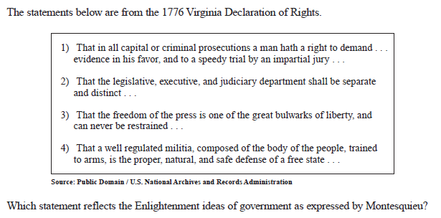
Checking for Understanding

